Slide 1
Autonomous Hovercraft Project
Group 11
ENGR 290 W2022
Preliminary
Design
Report
1

Slide 2
Introduction
Goal: Create autonomous hovercraft that can move and finish a certain track under 120 seconds
Thoughts, ideas and decisions
Fit into certain parameters
2

Slide 3
Design Specification
Linear acceleration
Angular acceleration
Lift
Thrust
Process
Sensors
3

Slide 4
Key Criteria
Turning Capability
Linear acceleration
Weight
Stability
Number of Components
Energy Efficiency
4

Slide 5
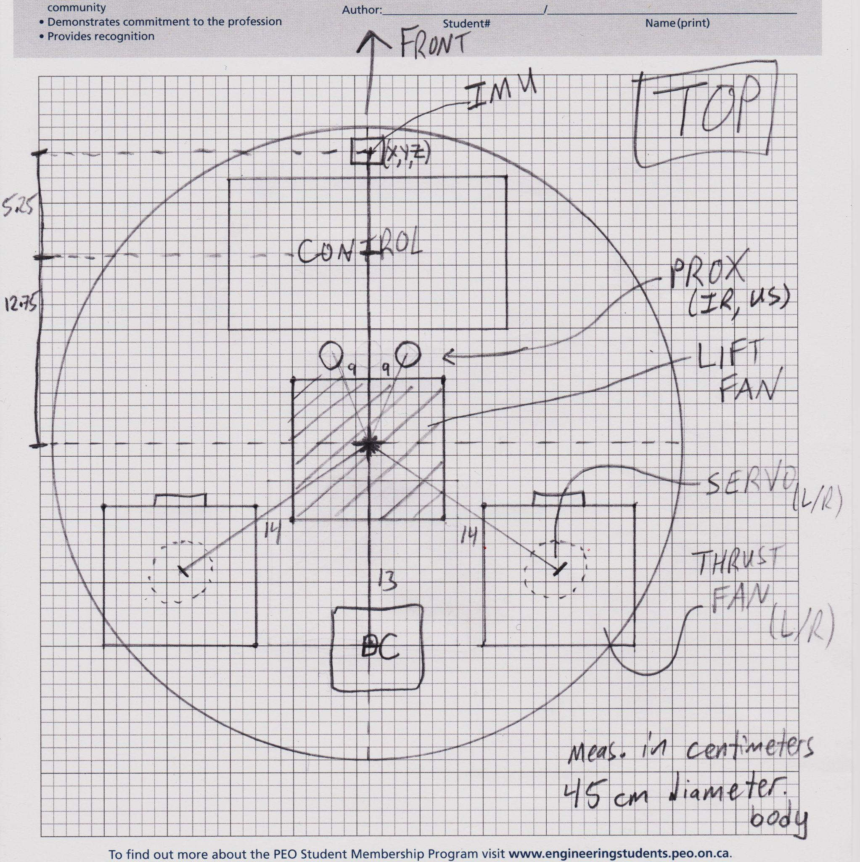
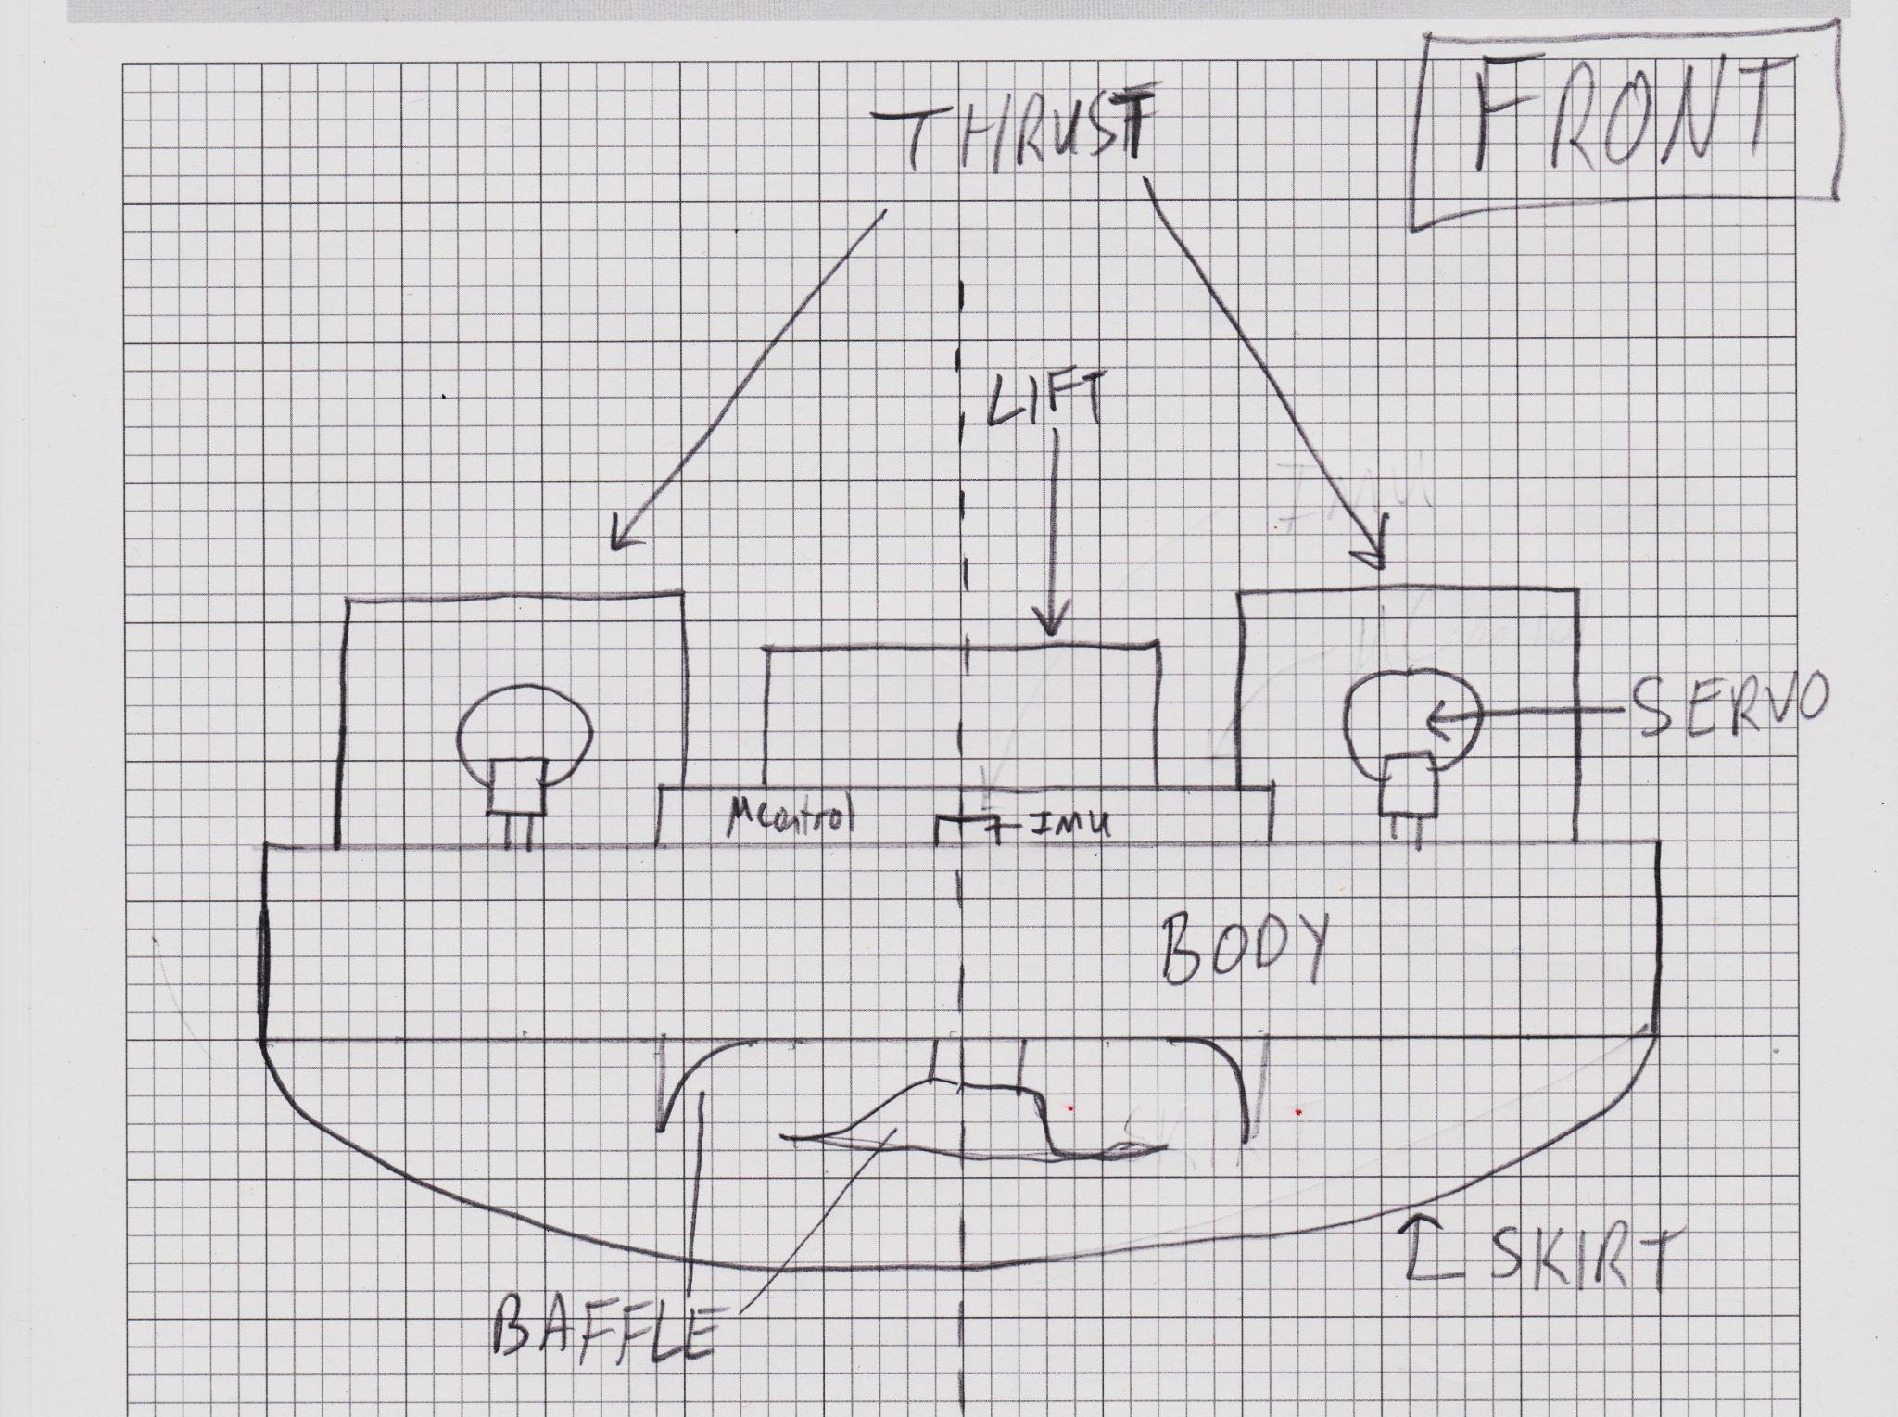
Design #1
5

Slide 6
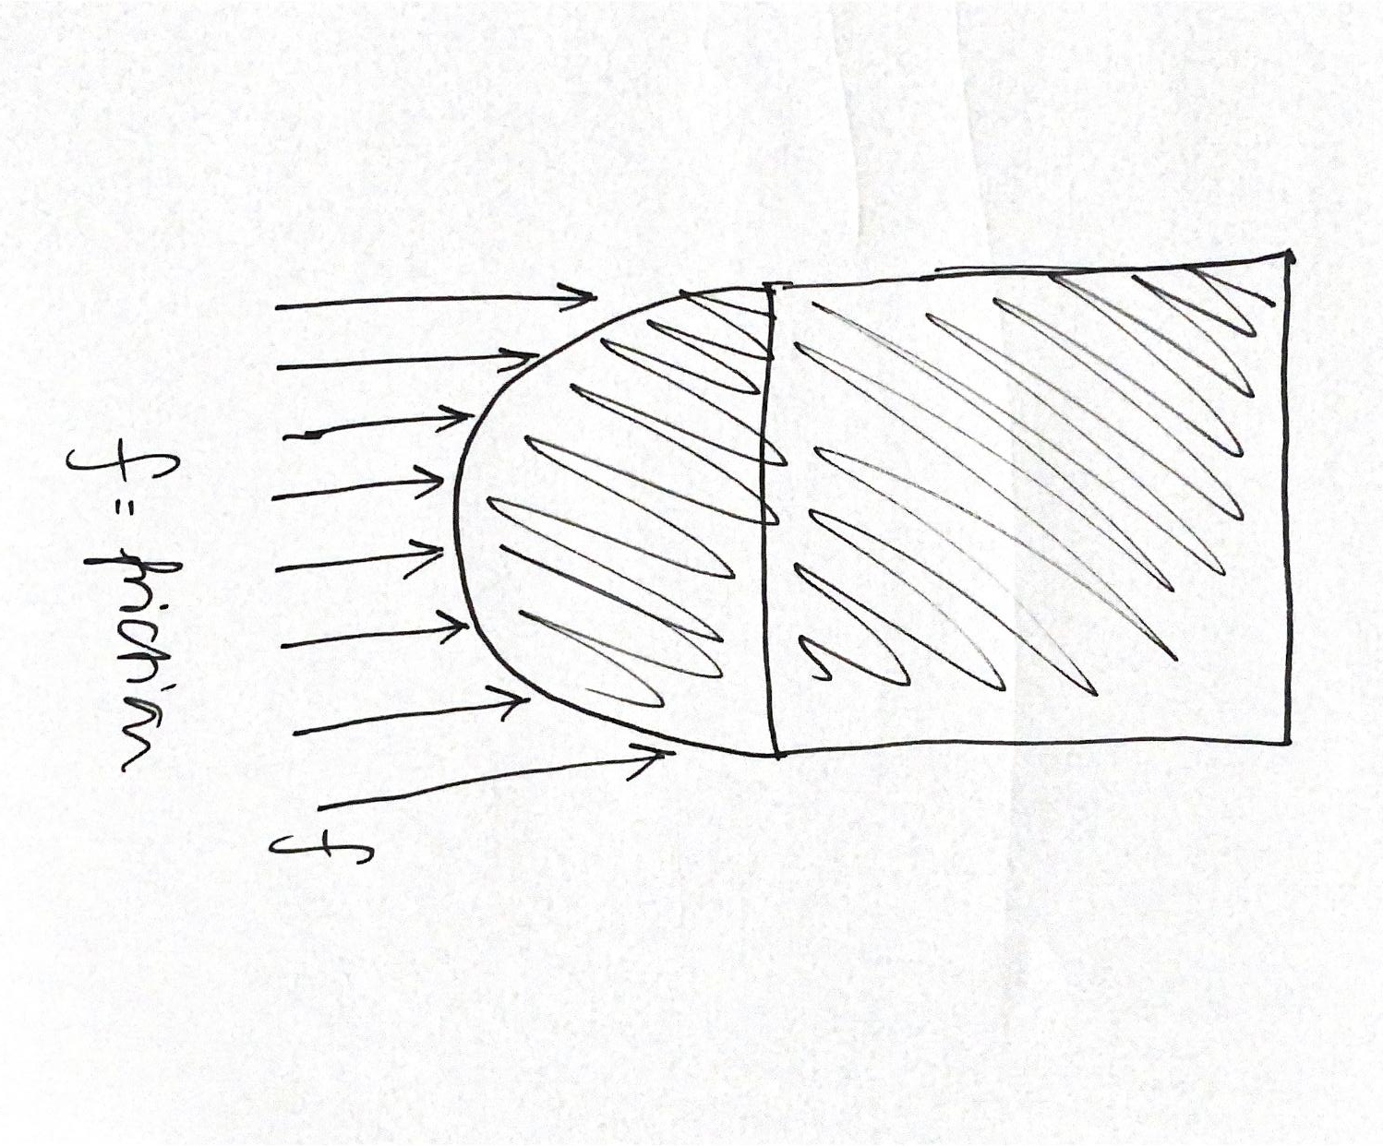
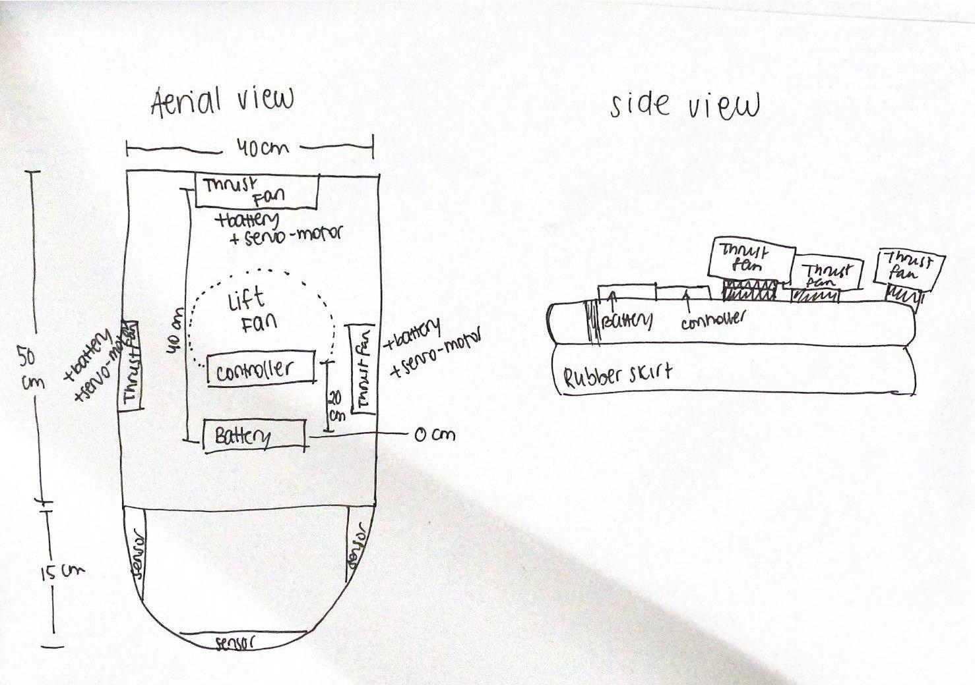
Design #2
6

Slide 7
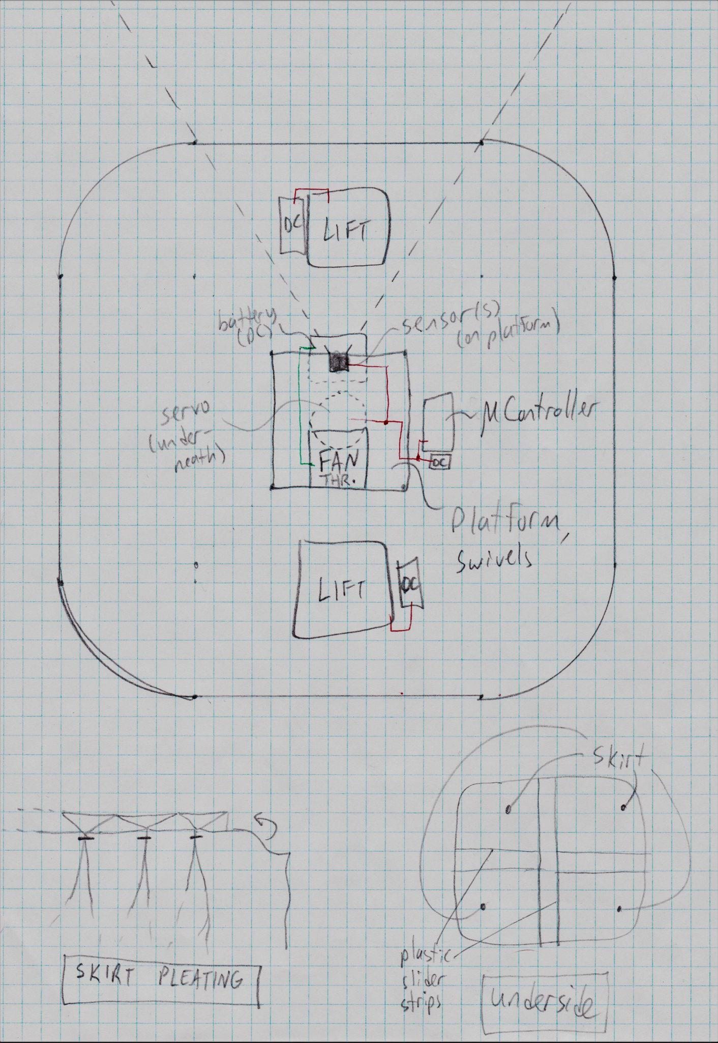
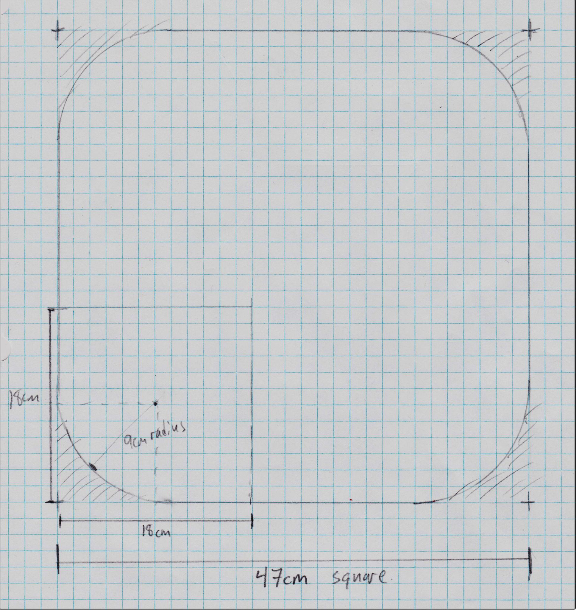
Design #3
7

Slide 8
Design Characteristics
Design Criteria
Base:
square with rounded corners
1 Thrust Fan
2 Lift Fans
2 Sensors
4 Batteries
1 Servo
1 Controller
1 IMU
Turning Capability: More freedom in rotation
Stability: Very stable due to placement of lift fans
Number of components:
Low (12)
Linear Acceleration: Not high, but will finish track on time
Energy Efficiency: High Energy Use
Weight: Large, causes lower velocity
8

Slide 9
Design Selection Process
SWOT, AHP and WOT analysis
SWOT analysis was performed on each design assessing their strength, weakness, opportunity, and threat.
AHP and WOT analysis were used to select the best design based on the priority of the criteria.
9

Slide 10
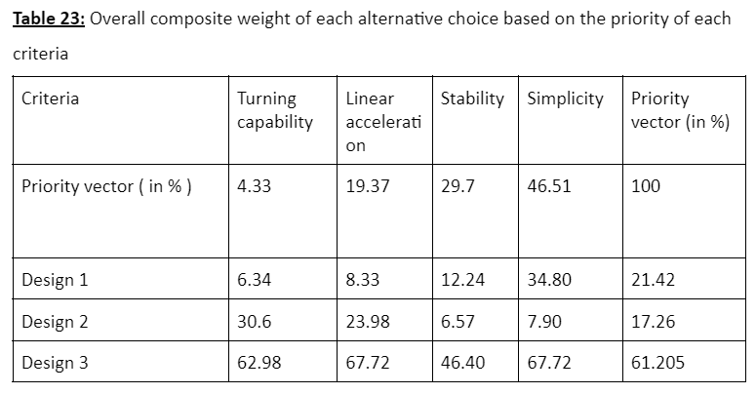
AHP Analysis
10

Slide 11
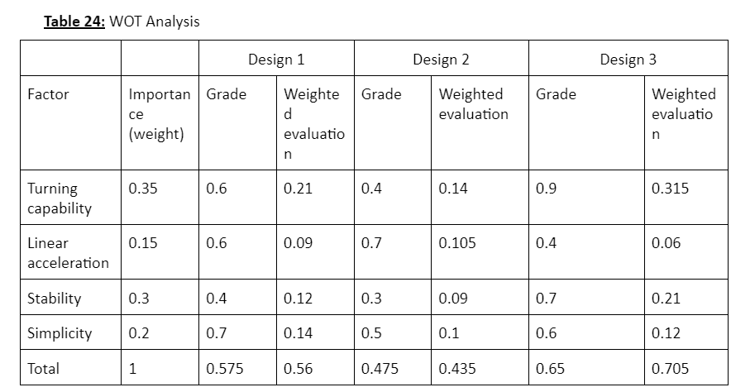
WOT Analysis
11

Slide 12
SWOT Analysis Overview
Design 1 and Design 2: higher linear acceleration
Design 3: Most stable, fewest components
Threat: 3 Obstacles of increasing height
12

Slide 13
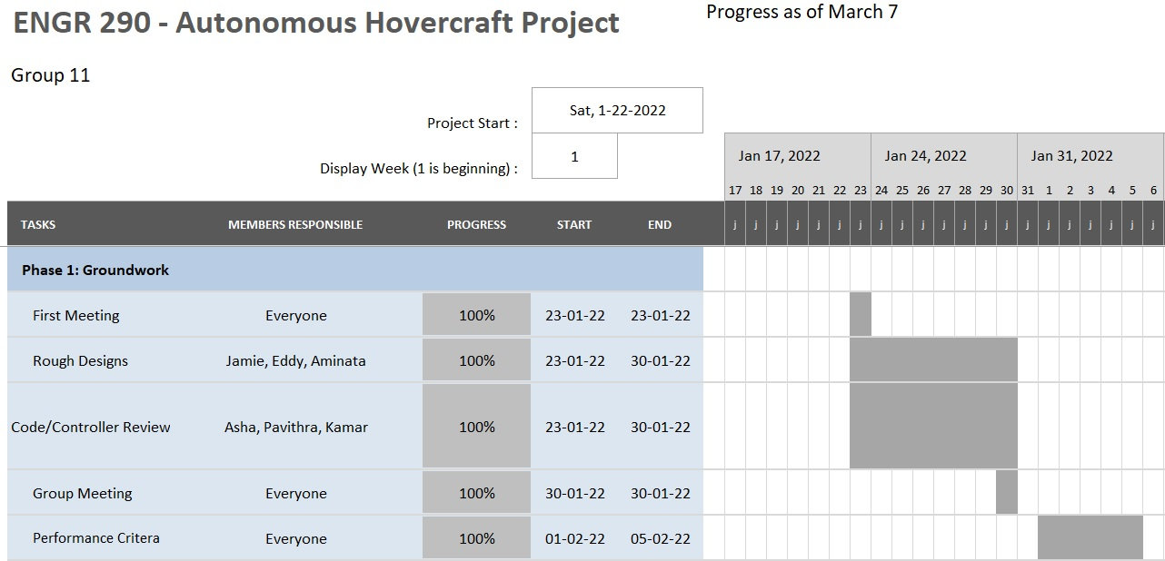
Gantt Chart
13

Slide 14
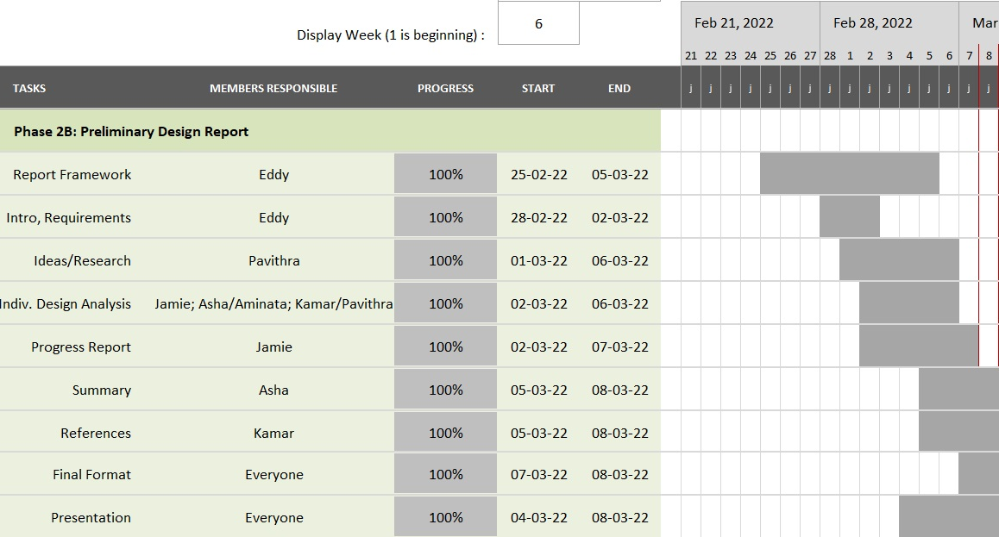
Gantt Chart
14

Slide 15
Summary
Designs created based on specifications, requirements, and criteria
SWOT, WOT, AHP analyses were used to choose the best design
Design 3 was chosen and simulated in MATLAB
15

